Slide 1
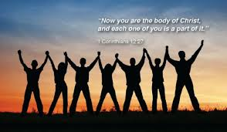
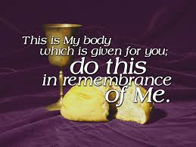
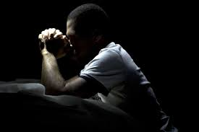
Devote Myself
Teacher: Sean Colosimo

Slide 2
Blessings v Curses
John 15:5 “I am the vine; you are the branches. If you remain in me and I in you, you will bear much fruit; apart from me you can do nothing.”
Surrender myself
Dedicate myself
Devote myself

Slide 3
John 15:9-17
V 9-10 “As the Father has loved me, so have I loved you. Now remain in my love. If you keep my commands, you will remain in my love…”
V 12-13 “My command is this: Love each other as I have loved you. Greater love has no one than this: to lay down one’s life for one’s friends.”
V 16-17 “You did not choose me, but I chose you and appointed you so that you might go and bear fruit—fruit that will last—and so that whatever you ask in my name the Father will give you. This is my command: Love each other.”

Slide 4
Devote Myself
Devote- Having strong love or loyalty for something or someone.
*Acts 2:42-47
Proskarteréō:
Consistently showing strength which prevails (in spite of difficulties); to endure (remain firm), staying in a fixed direction.
“To continue to do something with intense effort, with the possible implication of despite difficulty – 'to devote oneself to, to keep on, to persist in'"

Slide 5
1 Thessalonians 1:2-8
V3 “We remember before our God and Father your work produced by faith, your labor prompted by love, and your endurance inspired by hope in our Lord Jesus Christ.”
V6-8 “You became imitators of us and of the Lord, for you welcomed the message in the midst of severe suffering with the joy given by the Holy Spirit. And so you became a model to all the believers in Macedonia and Achaia. The Lord’s message rang out from you not only in Macedonia and Achaia—your faith in God has become known everywhere.”

Slide 6
1 and 2 Corinthians
Struggled to love one another: Instead of being loving they were loveless!
Divisions in the church
Proud of Sexual Immorality
Lawsuits among Believers
Spiritual pride over one another
Respecting spiritual authority
Trouble with taking advantage of communion

Slide 7
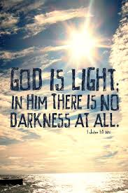
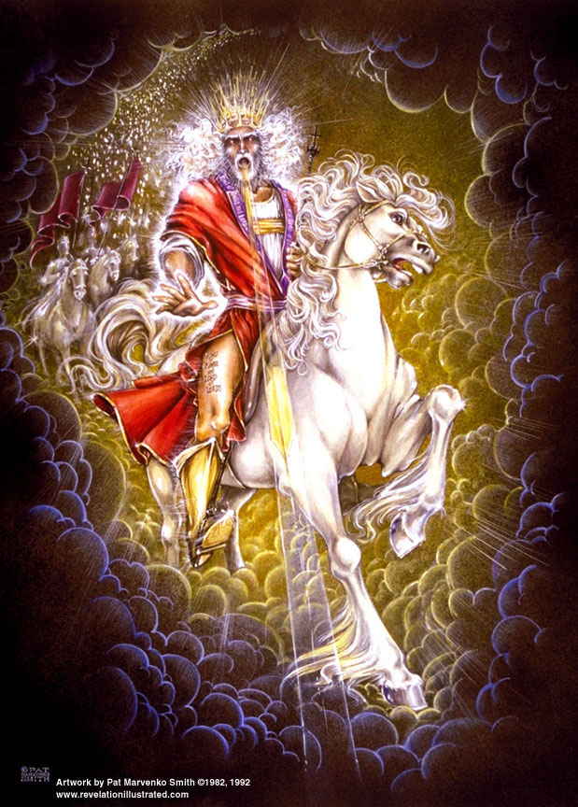
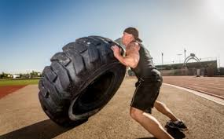
Devote myself to loving the fellowship
Walk in the light!
Obey the command!
Put in the work! The LABOR of love!

Slide 8
Walk in the light!
1 John 1:5-10
V 6-7 “If we claim to have fellowship with him and yet walk in the darkness, we lie and do not live out the truth. But if we walk in the light, as he is in the light, we have fellowship with one another…”
V9 “But if we confess our sins to Him…”
James 5:16 “Therefore confess your sins to each other and pray for each other so that you may be healed. The prayer of a righteous person is powerful and effective.”

Slide 9
Obey the command!
1 John 4:7-12
V7-9 God sets the standard for love
V10-12 Since God loved us…
1 John 4:19-21
V20 “hates” miséō – properly, to detest; hence, denounce; to love someone or something less than someone (something) else, i.e. to renounce one choice in favor of another

Slide 10
Put in the work! The LABOR of love!
1 Thessalonians 1:3 “…your labor prompted by love…”
kópos ("to hit, strike") – properly, a strike (blow) that is so hard, it seriously weakens or debilitates; (figuratively) deep fatigue, extreme weariness (wearisome toil).

