Slide 1
Trust in the LORD! Part II
By Sean Colosimo
Teacher

Slide 2
What does that mean?
Proverbs 3:5-6: “Trust in the Lord with all your heart and lean not on your own understanding; in all your ways submit to him, and he will make your paths straight.”

Slide 3
2 Timothy 3:15-17
“… and how from infancy you have known the Holy Scriptures, which are able to make you wise for salvation through faith in Christ Jesus. All Scripture is God-breathed and is useful for teaching, rebuking, correcting and training in righteousness, so that the servant of God may be thoroughly equipped for every good work.”
Romans 15:4- “For everything that was written in the past was written to teach us, so that through the endurance taught in the Scriptures and the encouragement they provide we might have hope.”

Slide 4
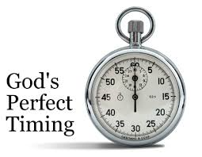
Timing is important to God!
Abraham- Was 75 years old (Genesis 11:30-12:1-3) at the time of his 1st Covenant with God, but 100 years old (Genesis 21:1-5) when Isaac was born.
David- There is a debate about how old David was when he was anointed king (1 Samuel 16:13). We do know, that David was 30 years old when he became king over Israel (2 Samuel 5:4).
Goliath noticed David was “little more than a boy” (1 Samuel 17:42)

Slide 5
Avoid The Trap!
Culture- Abram and Sarai having a child through Hagar
Genesis 16-28
Fear- David was tired of running from Saul and left for the Philistines
1 Samuel 27-30

Slide 6
What about us?

Slide 7
Numbers 3:8-10
So I have come down to rescue them from the hand of the Egyptians and to bring them up out of that land into a good and spacious land, a land flowing with milk and honey—the home of the Canaanites, Hittites, Amorites, Perizzites, Hivites and Jebusites. And now the cry of the Israelites has reached me, and I have seen the way the Egyptians are oppressing them. So now, go. I am sending you to Pharaoh to bring my people the Israelites out of Egypt.”
Fulfillment of God’s promise in Genesis 15:13-14

Slide 8
Going Backwards???
Bricks without straw (Exodus 5)
Pharaoh's resistance and the Plagues (Exodus 7-11)
God did not take them the fastest way intentionally (Exodus 13:17-18)

Slide 9
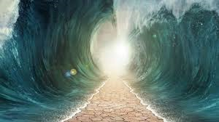
Hebrews 11:29
“By faith the people passed through the Red Sea as on dry land; but when the Egyptians tried to do so, they were drowned.”

Slide 10
Now what? Ex. 15-31 and Nu. 11-12
Two years after crossing the Red Sea the Israelites are not in the land of Milk and Honey (Numbers 1:1)
Grumbling over food and water
Ten Commandments
Golden Calf
Defeat Amalek’s in war
Laws of the Covenant
Specifications for the Tabernacle

Slide 11
Numbers 13:26-14:10
13:27 The promise of God was true! The Promise Land did flow with milk and honey!
13:28-29 and v31-33 The bad report ☹
14:1-4 The people rebel against Moses and Aaron

Slide 12
What can we learn?
1 Corinthians 10: 1-13
V5-6 “Nevertheless, God was not pleased with most of them; their bodies were scattered in the wilderness. Now these things occurred as examples to keep us from setting our hearts on evil things as they did.”
V13 “No temptation has overtaken you except what is common to mankind.”

Slide 13
What can we learn?
Hebrews 3:7-19
V8, 10, 12 and 15 all reference our hearts
V12 “See to it…”
V13 “Encourage one another daily…”

Slide 14
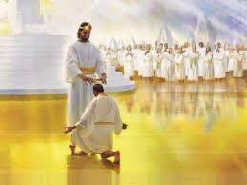
Hebrews 6:10
“God is not unjust; he will not forget your work and the love you have shown him as you have helped his people and continue to help them.”

