Slide 1
Frank Davis
Senior Pastor/Evangelist
Notes:
Babies…Football

Slide 2
Video
https://www.youtube.com/watch?v=_9ieb1Y1VCY
Notes:
The Chase… The Chain {Explain dilemma}

Slide 3
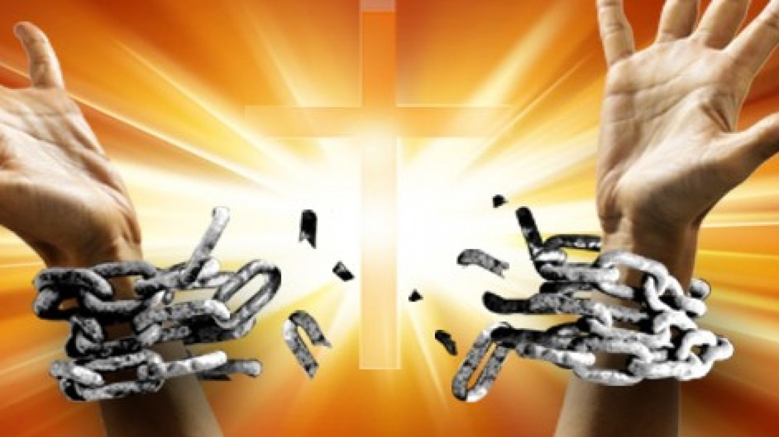
This Week…
Chain Breaker
Notes:
The Chase… The Chain {Explain dilemma}

Slide 4
Psalm 107:1-32, 43
Chain Breaker
Notes:
1. 1-3 Redeemed…Proclaim
2. 4-9 Wandered in Deserts {hurt loneliness}
3. 10-16 Sat In Darkness {addiction, generational sin, deep character…}
4. 17-22 Some became fools {rebellion, willful}
5. 23-32 Went out on the sea {Success}
6. 43

Slide 5
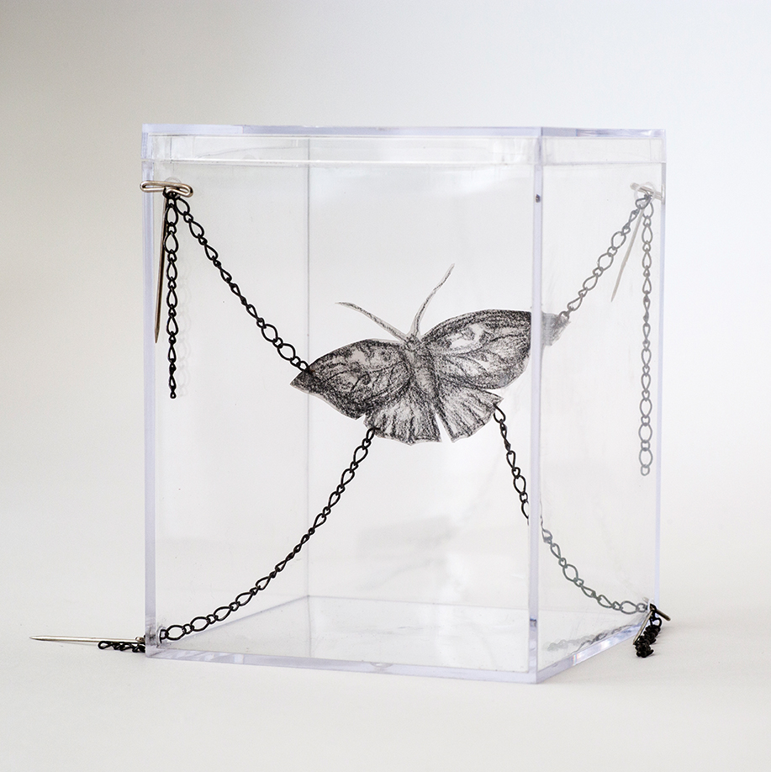
We All Have Chains
Notes:
A. We have Chains…Work In Progress (Us...the church)
B. What is Alarming Is not that We Have Chains It Is…
1. We’re Numb to Them {Me}…
2. Accept it
3. Defend Them
4. Make Excuses for Them {Not an accessory}
5. Cover Up {Couple I Knew…health} Fear Makes Your Worst Fears Come True!

Slide 6
Notes:
I. Jesus Is the Chain Breaker

Slide 7
Romans 7:25
25 Thanks be to God, who delivers me through Jesus Christ our Lord!
Notes:
Explain

Slide 8
John 8:31-32
31 To the Jews who had believed him, Jesus said, “If you hold to my teaching, you are really my disciples. 32 Then you will know the truth, and the truth will set you free.”
Notes:
Explain…Don’t Be afraid of the truth…

Slide 9
John 8:36
36 So if the Son sets you free, you will be free indeed.
Notes:
A. Explain
B. Pray
C. Read
D. Pray {To Hear God not Me…Made Up Our minds In Advance}
E. Fast
F. Confess
G. Seek Godly Counsel {Spiritual Truth Speakers}
H. Pray {Wisdom… Strength…Steve Franklin}
I. Make Tough Decisions
J. Pray Unceasingly
K. Rinse, Wash Repeat

Slide 10
Next Week…

