Slide 1
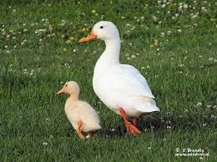
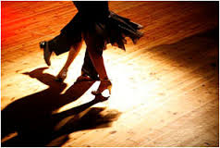
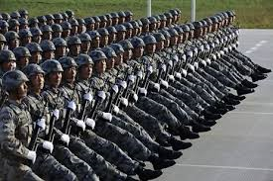
Keeping in Step
Teacher: Sean Colosimo

Slide 2
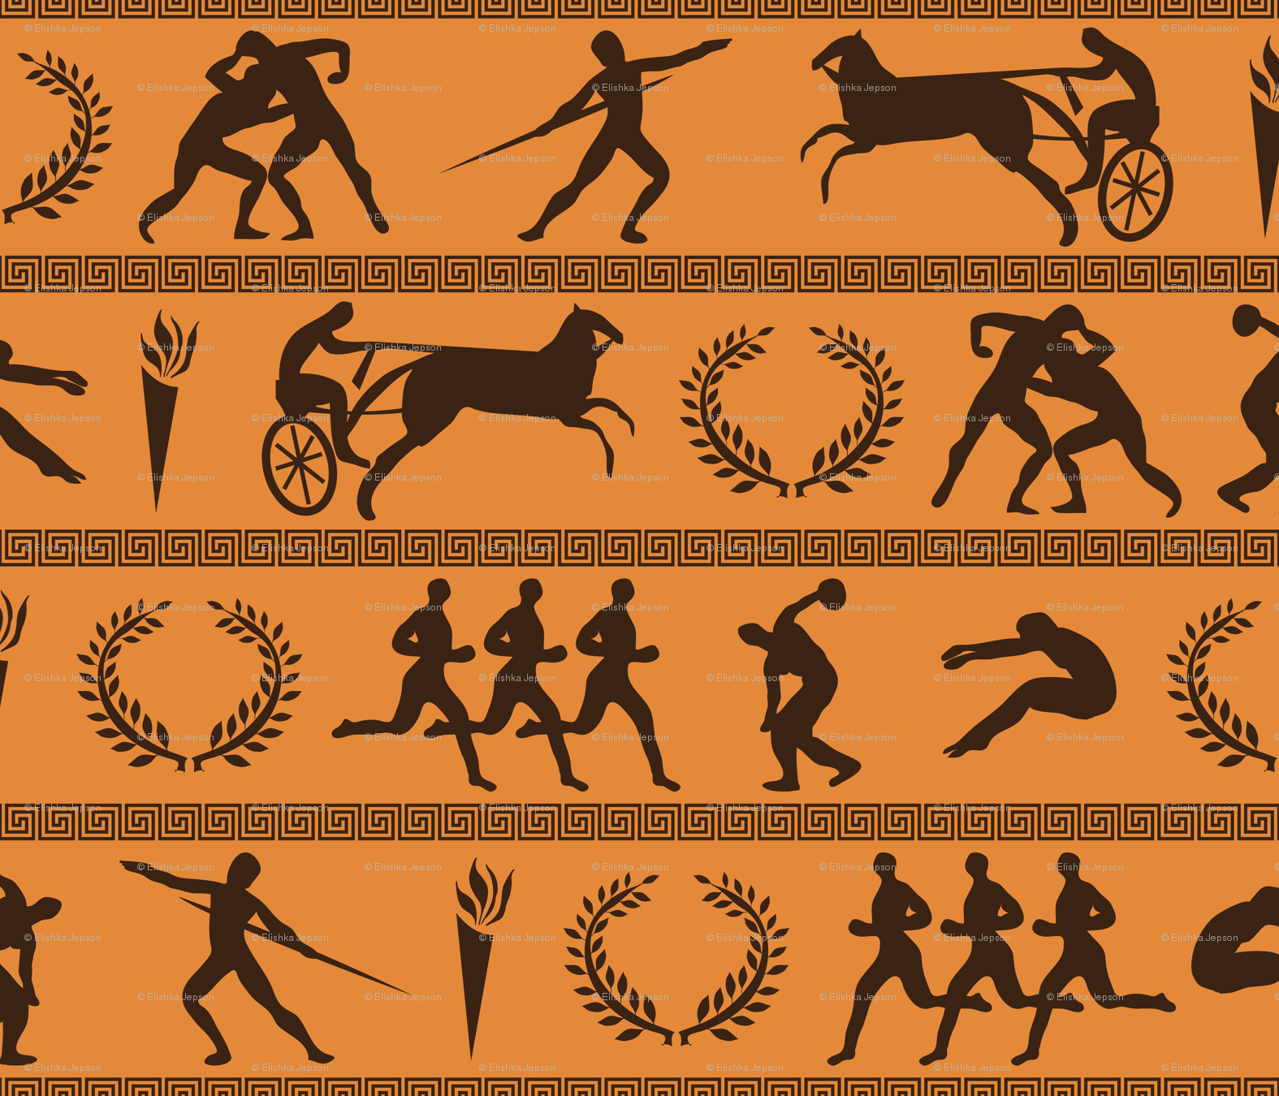
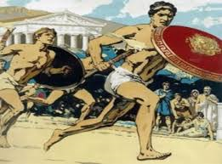
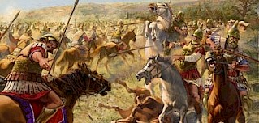
Colossians 1:26-29
28 He is the one we proclaim, admonishing and teaching everyone with all wisdom, so that we may present everyone fully mature in Christ. 29 To this end I strenuously contend with all the energy Christ so powerfully works in me.

Slide 3
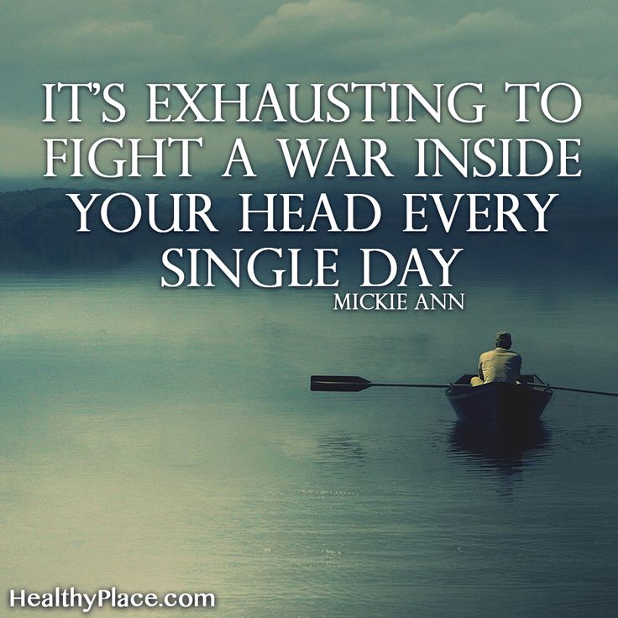
Colossians v 29
Strenuously-kopiáō ("exhausting labor") – to labor until worn-out, depleted (exhausted). Bodily or mentally labor alike.
Contend-agōnízomai ("conflict/struggle," the root of the English term, "agonize") – properly, to struggle, like engaged in an intense athletic contest or warfare

Slide 4
Galatians 5:16-18
So I say, walk by the Spirit, and you will not gratify the desires of the flesh. 17 For the flesh desires what is contrary to the Spirit, and the Spirit what is contrary to the flesh. They are in conflict with each other, so that you are not to do whatever you want. 18 But if you are led by the Spirit, you are not under the law.

Slide 5
Galatians 5:21-25

Slide 6
Galatians 6:1-10
Brothers and sisters, if someone is caught in a sin, you who live by the Spirit should restore that person gently. But watch yourselves, or you also may be tempted. 2Carry each other’s burdens, and in this way you will fulfill the law of Christ. 3If anyone thinks they are something when they are not, they deceive themselves. 4 Each one should test their own actions. Then they can take pride in themselves alone, without comparing themselves to someone else, 5 for each one should carry their own load.
6Nevertheless, the one who receives instruction in the word should share all good things with their instructor.
7 Do not be deceived: God cannot be mocked. A man reaps what he sows. 8 Whoever sows to please their flesh, from the flesh will reap destruction; whoever sows to please the Spirit, from the Spirit will reap eternal life. 9 Let us not become weary in doing good, for at the proper time we will reap a harvest if we do not give up. 10 Therefore, as we have opportunity, let us do good to all people, especially to those who belong to the family of believers.

Slide 7
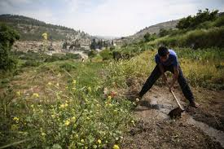
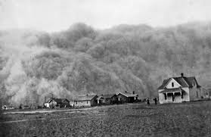
Challenges to Farming

Slide 8
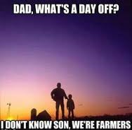

Slide 9
Galatians 5:17 Conflict 480 antíkeimai (from 473 /antí, "against" and 2743 /kautēriázō, "to place") – properly, place fully against, constitutionally oppose – like someone being thoroughly unreconcilable ("intractable, implacable").
Galatians 5:20
éris(a primitive word, NAS dictionary) – literally quarrel, strife; properly, a readiness to quarrel (having a contentious spirit), affection for dispute.
Erithea the seeking of followers and adherents by means of gifts, the seeking of followers, hence) ambition, rivalry, self-seeking; a feud, faction. ME FIRST
dixostasía (from dixa, "separately" and 4714 /stásis, "a standing, stance") – properly, separate-standings ("standing apart"), used of divisions which wrongly separate people into pointless (groundless) factions.
Hairesis a self-chosen opinion, a religious or philosophical sect,
Galatians 5:26
kenódoksos – properly, empty glory, i.e. self-deluded conceit driven by personal "delusions of grandeur"; "groundless conceit" (A-S); boasting "where there is nothing to boast about;
Prokaleo I provoke, stimulate, challenge, call out.
phthonéō – to envy, becoming bitter (sour) because of another person's success
Galatians 6:1
praótēs– properly, temperate, displaying the right blend of force and reserve (gentleness). 4236 /praótēs ("strength in gentleness") avoids unnecessary harshness, yet without compromising or being too slow to use necessary force.

