Slide 1
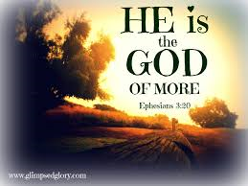
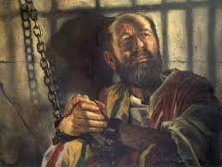
To live is Christ
Teacher: Sean Colosimo

Slide 2
Holy Spirit Review
Holy Spirit 101
The Same Power
Test Yourself Part I
Test Yourself Part II
Keeping In Step
To Live is Christ

Slide 3
Where does that leave us now?
“Secret things belong to God…” Deuteronomy 29:29
“Now to Him who can do immeasurably more than we can ask or imagine according to His power that is at work within us (Ephesians 3:20).”
God expects our obedience to receive the gift of His Holy Spirit!
Our relationships are a direct reflection of whether we are “keeping in step” with the Spirit.
How do I make the most of Christ being inside me and what should I expect from Him?

Slide 4
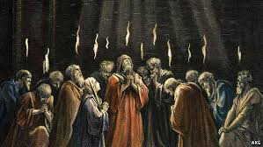
Acts
When reading the bible, consider whether you are reading about the miraculous works or seal of the Holy Spirit
Hebrews 2:3-4 This salvation, which was first announced by the Lord, was confirmed to us by those who heard him. 4 God also testified to it by signs, wonders and various miracles, and by gifts of the Holy Spirit distributed according to his will.

Slide 5
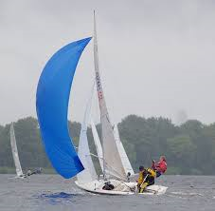
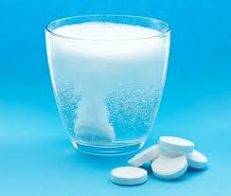
Being Filled with the Holy Spirit
Ephesians 5:18 “…instead, be filled with the Spirit…”
Filled comes from the Greek word Pleroursthe which is broken down into pleroo
Pressure- Wind pressuring a vessel across the sea
Permeation- Alka Seltzer
Domination- Total Control

Slide 6
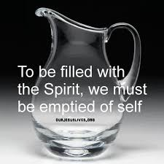
Why is it so hard?
1 Corinthians 10:13 “No temptation has overtaken you except what is common to mankind.”

Slide 7
Philippians 1:19-21
“Yes, and I will continue to rejoice, 19 for I know that through your prayers and God’s provision of the Spirit of Jesus Christ what has happened to me will turn out for my deliverance. 20 I eagerly expect and hope that I will in no way be ashamed, but will have sufficient courage so that now as always Christ will be exalted in my body, whether by life or by death. 21For to me, to live is Christ…”

Slide 8
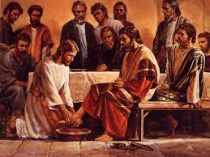
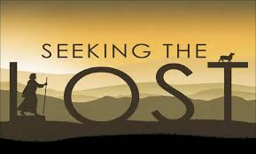
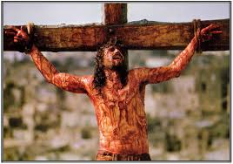
Philippians 2:5-8
v5 In your relationships with one another, have the same mindset as Christ Jesus:
6 Who, being in very nature God,
did not consider equality with God something to be used to his own advantage;
7 rather, he made himself nothing
by taking the very nature of a servant,
being made in human likeness.
8 And being found in appearance as a man,
he humbled himself
by becoming obedient to death—
even death on a cross!

