Slide 1
Frank Davis
Senior Pastor/Evangelist
Notes:
Babies…Football

Slide 2
Video
https://www.youtube.com/watch?v=bPhqMJpQsYQ
Notes:
Xmas we forget

Slide 3
This Week…
Notes:
We are the same. WE share a faith in something amazing

Slide 4
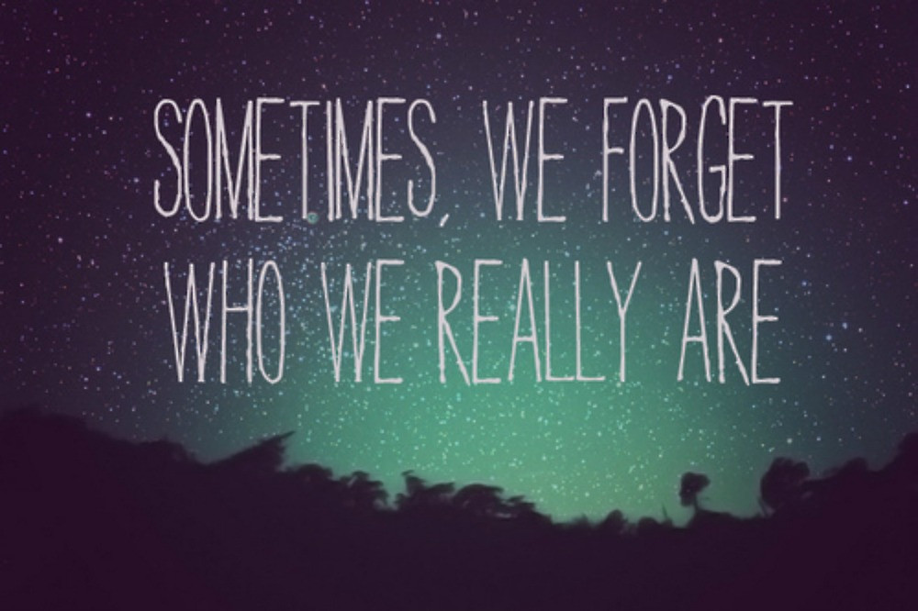

Slide 5
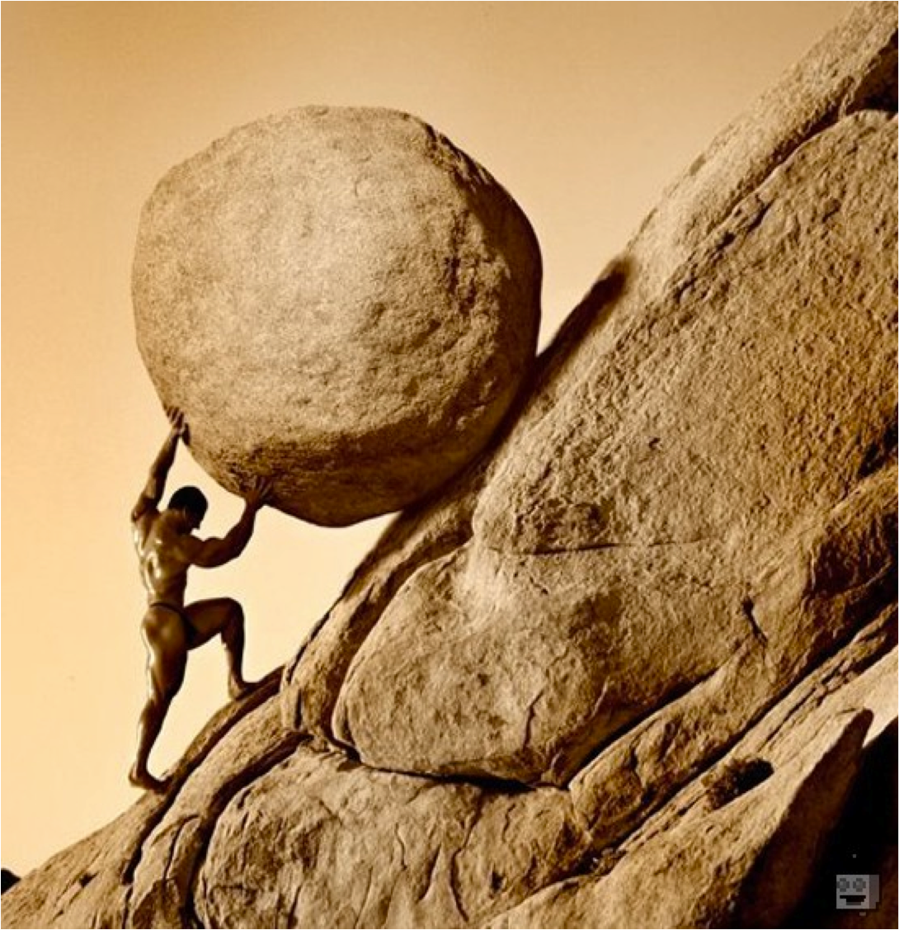
Sometimes
It’s Hard
Notes:
We forget why…
1. Pure
2. Righteous
3. Invest
4. Give
5. Sacrifice

Slide 6
40:1-14
Notes:
Job struggled but didn’t quit...
• Lost everything
• Friends Hurt not Helped
• God seemed silent
• Grumbled

Slide 7
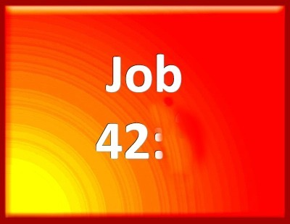
7
7 After the Lord had said these things to Job, he said to Eliphaz the Temanite, “I am angry with you and your two
Notes:
God was Pleased with Job’s response…why?

Slide 8
1-2
Then Job replied to the Lord:
2
“I know that you can do all things;
no purpose of yours can be thwarted.

Slide 9
3
3
You asked, ‘Who is this that obscures my plans without knowledge?’
Surely I spoke of things I did not understand,
things too wonderful for me to know.

Slide 10
4
4
“You said, ‘Listen now, and I will speak;
I will question you,
and you shall answer me.’

Slide 11
5-6
5
My ears had heard of you
but now my eyes have seen you.
6
Therefore I despise myself
and repent in dust and ashes.”
Notes:
A. God Is Big
B. He deserves all trust
C. He has not forgotten me
D. He care for me
E. He will always take care of me.

Slide 12
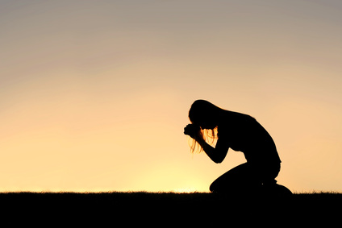
Bow Down
Notes:
II. Bow Down
A. Repent
B. Let Go
C. Go

Slide 13
Next Week…

