Slide 1
Frank Davis
Senior Pastor/Evangelist

Slide 2
Notes:
Football Update

Slide 3
This Week…
The Fourth
Man
Notes:
Football Update

Slide 4
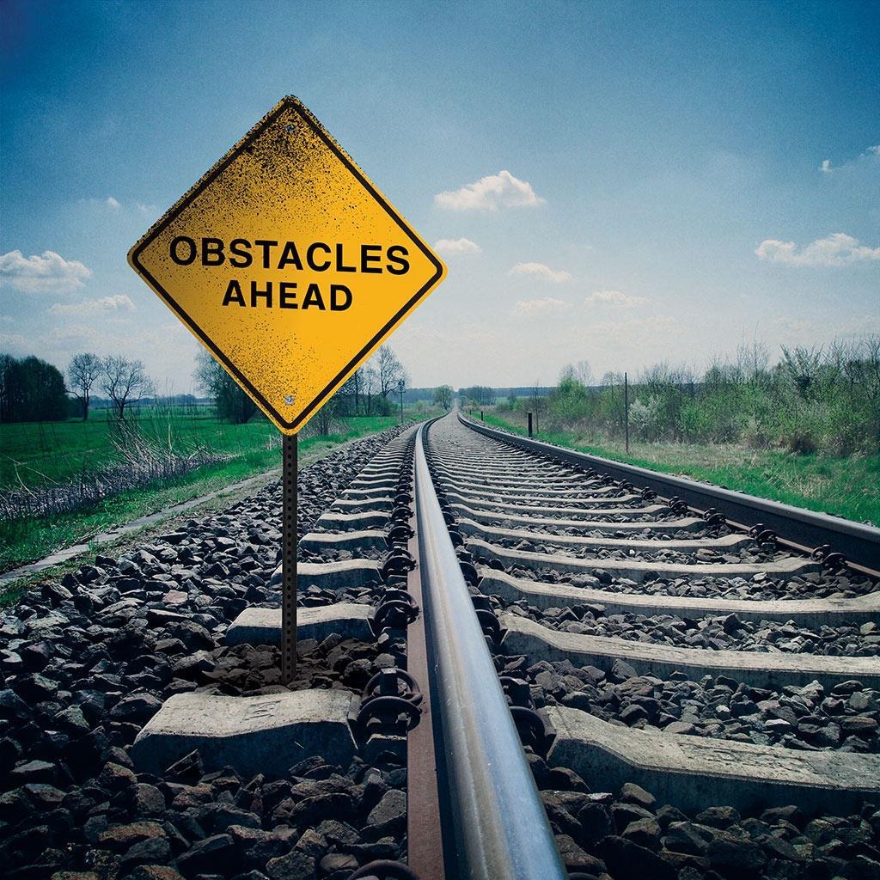
God is a
Notes:
Daniel 3:1-3
Statue…Ninety feet High & nine feet high (sixty by six cubits)

Slide 5
Daniel 3:8-10
8 At this time some astrologers[b] came forward and denounced the Jews. 9 They said to King Nebuchadnezzar, “May the king live forever! 10 Your Majesty has issued a decree that everyone who hears the sound of the horn, flute, zither, lyre, harp, pipe and all kinds of music must fall down and worship the image of gold,
7 Accept one another, then, just as Christ accepted you, in order to bring praise to God.
Notes:
Adversity

Slide 6
Daniel 3:11-12
11 and that whoever does not fall down and worship will be thrown into a blazing furnace. 12 But there are some Jews whom you have set over the affairs of the province of Babylon—Shadrach, Meshach and Abednego—who pay no attention to you, Your Majesty. They neither serve your gods nor worship the image of gold you have set up.”
7 Accept one another, then, just as Christ accepted you, in order to bring praise to God.
Notes:
Adversity

Slide 8
Daniel 3:13-14
13 Furious with rage, Nebuchadnezzar summoned Shadrach, Meshach and Abednego. So these men were brought before the king, 14 and Nebuchadnezzar said to them, “Is it true, Shadrach, Meshach and Abednego, that you do not serve my gods or worship the image of gold I have set up?
Notes:
Adversity

Slide 9
Daniel 3:13-15
15 Now when you hear the sound of the horn, flute, zither, lyre, harp, pipe and all kinds of music, if you are ready to fall down and worship the image I made, very good. But if you do not worship it, you will be thrown immediately into a blazing furnace. Then what god will be able to rescue you from my hand?”
7 Accept one another, then, just as Christ accepted you, in order to bring praise to God.
Notes:
Tempted to Compromise
Will God Catch Me…
{Royal & Rochelle Williams}

Slide 10
The Fourth
Man
Notes:
Football Update

Slide 11
Daniel 3:16-26
Notes:
Royale and Rochelle Williams

Slide 12
Daniel 3:16-18
16 Shadrach, Meshach and Abednego replied to him, “King Nebuchadnezzar, we do not need to defend ourselves before you in this matter. 17 If we are thrown into the blazing furnace, the God we serve is able to deliver us from it, and he will deliver us[c] from Your Majesty’s hand. 18 But even if he does not, we want you to know, Your Majesty, that we will not serve your gods or worship the image of gold you have set up.”
Notes:
They gambled on the unseen

Slide 13
Daniel 3:25
25 He said, “Look! I see four men walking around in the fire, unbound and unharmed, and the fourth looks like a son of the gods.”
Notes:
Faith

Slide 14
The Fourth Man
What are you going to do today?
What are you going to do?
Who are you going to be ,today?
Who are you going to be?
7 Accept one another, then, just as Christ accepted you, in order to bring praise to God.
Notes:
Adversity

Slide 15
Are you the one who shrinks or stands up tall?
The one who soars or whose faith falls?
Will you answer, “Yes” to your Lord’s call?
Trust in God or trust in what you see?
7 Accept one another, then, just as Christ accepted you, in order to bring praise to God.
Notes:
Adversity

Slide 16
What are you going to do today?
What are you going to do?
Who are you going to be ,today?
Who are you going to be?
7 Accept one another, then, just as Christ accepted you, in order to bring praise to God.
Notes:
Adversity

Slide 17
Are you convictions’ child or one who fades
the one who runs, the one who’s swayed,
The one who doubts, the one who prays,
The one who stands or will you just bow down.
Notes:
Adversity

Slide 18
Three men stood by the furnace door,
Felt the heat rising from the floor.
They stepped in and took a stand,
Danced in the flame with the 4th man.
That was them, this is you.
Tell me, what are you going to do?
Notes:
Adversity

Slide 19
Life is coming, coming hard.
Trials are coming, coming fast.
Tears they flow like falling rain,
New day, new hope, new joy, new pain
Same choice, just like before,
The fourth man’s knocking on your door.
Just like before, the choice is clear.
Give in to doubt or face your fears.
Notes:
Adversity

Slide 20
And so we’re at the same refrain
Answering the questions that remain.
What are you going to do today?
What are you going to do?
Who are you going to be ,today?
Who are you going to be?
Notes:
Adversity

